Slide 1
Distributed Audio DSP Middleware for
Resource-Constrained Hosts
Milestone 3
Paul Bonargo Jr.
M.S. Computer Science
Rochester Institute of Technology

Slide 2
Current Status
This milestone, the Python node became a native C++/JUCE service, and a reliable TCP control plane now connects host and node, with automatic reconnection
Hosting real VST3s moved intact to Milestone 3+ its two prerequisites are built and validated
Goal unchanged: offload real-time plugin DSP to Local, LAN, and Cloud processing nodes
Milestone 1
one-way transport
Milestone 2
processed round-trip
Milestone 3
node + control plane
Milestone 3+
complete VST3 hosting
Notes:
M1 was a one-way pipe; the hard part of M2 is making the round trip transparent. The middleware layer — scheduler and coordinator — is now in progress for M3. (~1:30)

Slide 3
System Design: Peer-to-Peer, LAN-First
DAW HOST
LOCAL Peer
same-machine node
VST3 send/return
standalone plugin
Direct Peer Connection
audio (UDP :9000/:9001) control (TCP :9100)
LAN Peer: C++/JUCE node
validated: echo engine + live counters
Ableton Live 12
integrated plugin
CLOUD Peer
license-aware offload
COORDINATION
control plane
scheduler
failover
Notes:
M1 was a one-way pipe; the hard part of M2 is making the round trip transparent. The middleware layer — scheduler and coordinator — is now in progress for M3. (~1:30)

Slide 4
Two Planes: Audio in UDP, Control in TCP
DAW HOST
PROCESSING NODE
dry audio - UDP :9000
VST3 send/return
plugin
C++/JUCE
echo engine
processed audio - UDP :9001
Ableton Live 12
hosted VST3 - M3+
control - TCP :9100 (JSON)
Notes:
M1 was a one-way pipe; the hard part of M2 is making the round trip transparent. The middleware layer — scheduler and coordinator — is now in progress for M3. (~1:30)

Slide 5
Deliverable: Reliable TCP Control Plane
Plugin (host)
Node
HELLO - sample rate, block size
control must never drop
audio must never wait, so it stays on UDP
length-framed JSON messages
Connect retargets audio and control at runtime, no rebuild
auto-reconnect validated at ~1-2 s
HELLO_ACK + PLUGIN_LIST
SELECT_PLUGIN
PLUGIN_SELECTED - parameters and latency
SET_PARAM (fire-and-forget)
✕
node killed
1 s retry, reconnected in < 2 s
Notes:
Why the ReceiverThread + PlaybackBuffer split mirrors M1's design — a missed audio deadline is still audible, so receiving over a socket can no more run on the audio thread than sending could. Symmetry, for the same reason. (~2:00)

Slide 6
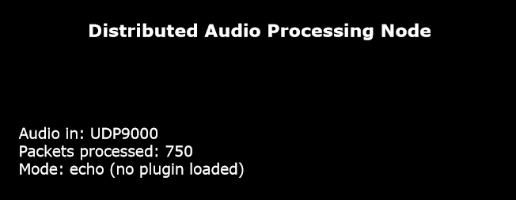
Validated: Audio Processing Node
Node and Sender - Initial
375 Packets/second - 2 seconds
Sender - After Node Shutdown
Node and Sender - After Node Restart
Notes:
Test 2 is the fast sanity test — if the return is audibly low-passed, it cannot be the dry signal leaking through, so the whole round trip is proven in one listen. The underrun row proves failure is graceful, not glitchy. (~1:30)

Slide 7
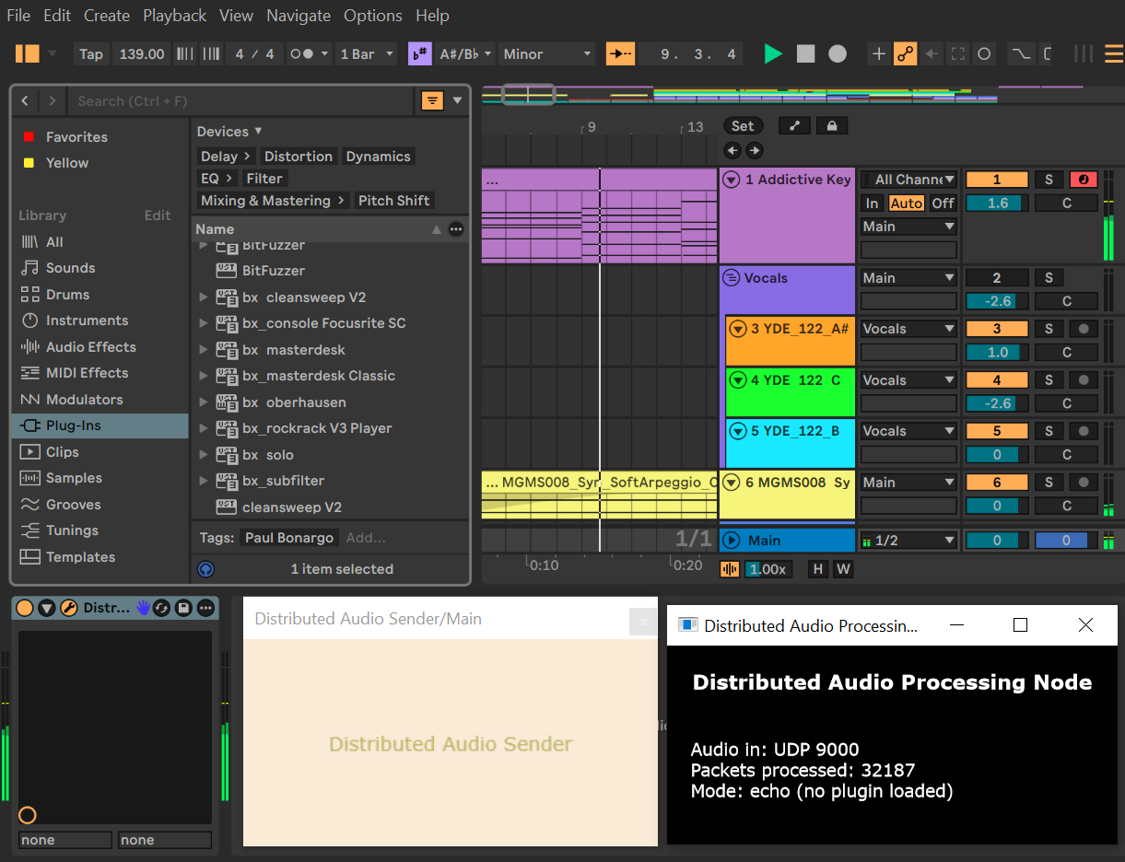
Validated: Audio Processing Node With Ableton Project
Notes:
Test 2 is the fast sanity test — if the return is audibly low-passed, it cannot be the dry signal leaking through, so the whole round trip is proven in one listen. The underrun row proves failure is graceful, not glitchy. (~1:30)

Slide 8
Roadmap
Milestone 3+
Beyond
Registry-driven, selectable VST3 plugins on the node
Plugin-scaling parameter UI and hosted-plugin latency folded into PDC
Live plugin use metrics
Offline TCP-based lossless freeze/flatten (capture, remote process, cache locally)
Cloud tier with license-aware offloading
< 10 ms
3
> 99%
Round Trip
Per Buffer
Compute
Tiers
Live Playback
Accuracy
Notes:
M2 deliberately used a built-in DSP node to isolate the hard transport-and-latency problem; now that the round trip is transparent and in sync, M3 — the middleware layer, now in progress — can drop real plugins into the same proven pipe. (~0:45)

Slide 9
Q&A
Any Questions?

